Slide 1

ALT S905X3 OTT Stick Proposal
May 14th 2020

Slide 2
Outline
Reference Projects
Spec Proposal
WiFi Testing
Milestone & Reliability Test Plan

Slide 3
Reference Project

Slide 4
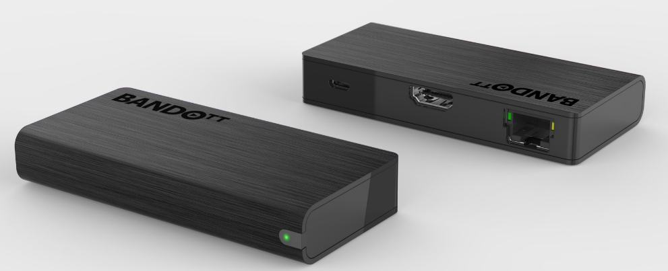
Reference Project 1
OTT Box ID
Technical Specification
Chipset | Memory
AML S805Y Quad core ARM Cortex-A53 CPU up to 1.5GHz Penta-core ARM Mali-450 GPU up to 750MHz+ | 1 GB DDR3 8 GB eMMC flash (MLC type)
Interface | Features
HDMI 2.0b @ 1080p60 output x1, HDCP 2.2 RJ-45x1; 10Mpbs/100Mpbs LED for power on/off indication Micro-USB for 5V @ 1A DC input | Main stream box for HEVC Full HD video HLS/MS Smooth Streaming/MPEG-DASH, Google casting support BT Voice control Preload apps for TV services Over-The-Air image upgrade Android TV certificated Netflix NTS certificated
Networking | Remote Control
10/100 Base-T Ethernet Wi-Fi 11n single band 1T1R Bluetooth 4.2 w/ BLE | BT4.2 RCU w/ voice input (with 4 hot keys)
Multimedia | Operating System
Decode H.265 HEVC MP-10@L4.1 up tp 1080P60 H.264 AVC HP@L4.2 up to 1080P30 VP9 profile-2 up to 1080P60 Encode H.264 up to 1080p30 | Android 9.0 Widevine Level 1/PlayReady DRM support
Highlight
Dimension | - 97.2mm x 45.5mm x 17.48mm
Wi-Fi 2.4G 1T1R Connection | - Support 11N single band 1T1R - Data rate up to 150Mbps
Operation environment | Temperature 0 ~ 40°C Humidity 10% ~ 90% relative humidity
Power adapter | 100~240VAC input, 5V/1A DC output
Safety Certification
Confidential

Slide 5
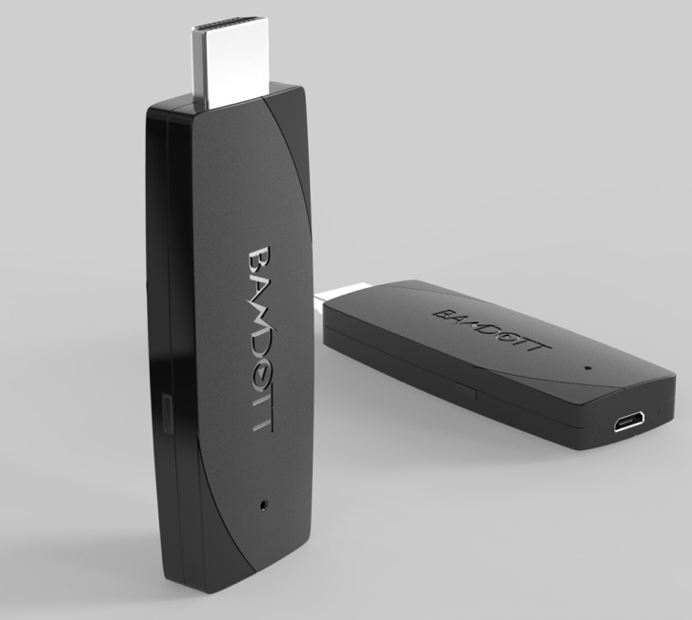
Reference Project 2
OTT Box ID Illustration
Technical Specification
Chipset | Memory
AML S912-J Android 7.1 | 2 GB DDR4 16 GB eMMC flash
Interface | Features
HDMI 2.0b @ 4K2Kp60 output x1, HDCP 2.2 LED for power on/off indication Micro USB for DC input | Main stream box for HEVC/4K2K video Super smooth streaming, 4K 60fps decoding Google casting support Voice control
Networking | Remote Control
Wi-Fi 802.11 ac/a/b/g/n 1x1 dual band 10/100 Base-T Ethernet ( via adapter ) Bluetooth 4.1 w/ BLE | BT 4.0
Multimedia | Operating System
Decode H.265 HEVC MP-10@L5.1 4K2Kp60 H.264 AVC HP@L5.1 up to 4K2Kp30 VP9 profile 2 4K2Kp60 Dolby Vision and HDR10 support | Android TV WideVine level 1/Playready DRM support
Highlight
Dimension | T: 11.1mm; W: 30mm; L: 70.2mm
Wi-Fi | Wi-Fi 802.11 ac/a/b/g/n 1x1 dual band
Operation environment | Temperature 0 ~ 40°C Humidity 10% ~ 90% relative humidity
Power adapter | DC 5V 1.2A
Safety/ Cert.
5
Notes:
1. 一組 S/PDIF
2. 兩組 USB
3. 一組 Composite
5

Slide 6

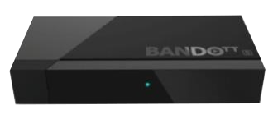
Reference Project 3
ID
Technical Specification
Chipset | Memory
AML S905D Quad-Core Cortex-A53, 18,400DMIPS ARM Mali-G31 MP2, 850MHz | 1 /2 GB DDR4 (Optional) 8 /16 GB eMMC flash (MLC type) (Optional)
Interface | Features
HDMI 2.0b @ 4Kp60 output x1, HDCP 2.2 RJ-45 x1; 10Mbps / 100Mbps through PSU (option) | Main stream box for HEVC/4K video HLS/MS Smooth Streaming/MPEG-DASH, BT Voice control Android TV certificated Netflix NTS certificated (Optional)
Multimedia | Operating System
Decode H.265 HEVC MP-10@L5.1 up to 4Kp75 H.264 AVC HP@L5.1 up to 4Kp30 VP9 profile 2 up to 4Kp60 Encode H.264/H.265 up to 1080p60 | Android TV 9.0 Widevine Level 1/PlayReady DRM support
 | Remote Control
 | BT 4.2 RCU w/ voice input
Basic
Dimension | - 84.6mm(W) x 39.6mm(D) x 15mm(H)
Networking | Wi-Fi 802.11 ac 1T1R single band Bluetooth 4.1 w/ BLE
Operation environment | Temperature 0 ~ 40°C Humidity 10% ~ 90% relative humidity
Power adapter | 100~240V AC input, 5V/1A DC output
Safety Certification

Slide 7

Reference 4: BANDOTT Smart Home Gateway Spec
OTT Box ID
Technical Specification
Chipset | Memory
AML S905D Quad-core 64bit ARM Cortex-A53 up to 2.0 GHz, Penta-cores Mali-450 up to 750MHz | 2 GB DDR3 8 GB eMMC flash (MLC type)
Interface | Features
HDMI 2.0b @ 4Kp60 output x1, HDCP 2.2 HDMI input x 2 up to 1080i resolution USB 2.0 Host Type A x1 RJ-45 x1; 10Mbps / 100Mbps LED for power on/off indication Reset button IR extender (3.5mm phone jack) DC jack for 5V @ 2A DC input | Main stream box for HEVC/4K video HLS/MS Smooth Streaming/MPEG-DASH, 4K 60fps decoding Google casting support BT Voice control Preload apps for TV services Over-The-Air image upgrade Android TV certificated Netflix NTS certificated
Networking | Remote Control
Wi-Fi 802.11 ac/a/b/g/n 2x2 dual band 10/100 Base-T Ethernet Bluetooth 4.1 w/ BLE | BT4.0 or IR based RCU
Multimedia | Operating System
Decode H.265 HEVC MP-10@L5.1 4Kp60 H.264 AVC HP@L5.1 up to 4Kp30 VP9 profile 2 4Kp60 Encode H.264 1080p60 | Android 7.1 Widevine Level 1/PlayReady DRM support Dolby AC3 support
Highlight
Dimension / Weight | - 140× 127 × 29 mm / 315g
Wi-Fi 2.4/5GHz 2T2R Connection | - Support 802.11 ac/a/b/g/n - Data rate up to 866Mbps
Operation environment | Temperature 0 ~ 40°C Humidity 10% ~ 90% relative humidity
Power adapter | 100~240VAC input, 5V/2A DC output
Safety Certification | BSMI / NCC certification
7
Notes:
1. 一組 S/PDIF
2. 兩組 USB
3. 一組 Composite
7

Slide 8
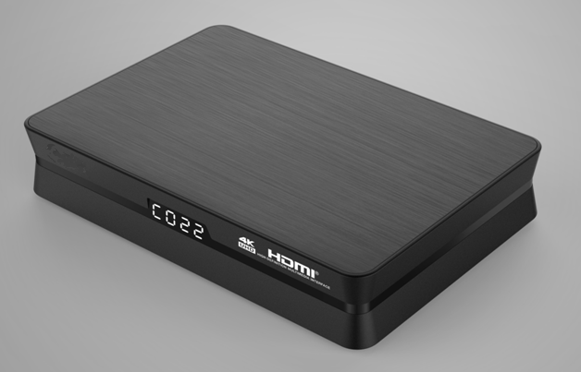
Reference 5: DVB-C 4K Hybrid OTT Specification
4K Hybrid Box
Technical Specification
Chipset | Memory
Realtek RTD1611 | 2 GB DDR4 8 GB eMMC flash (MLC type)
Interface | Features
HDMI 2.0b @ 4Kp60 output x1, HDCP 2.2 USB3.0 Host Type A x 2 RJ-45 x1; 10/ 100 Mbps AV output (3.5mm phone jack) x 1 F-type CON x1; DVB-C Full-Band captured tuner x 1 7-Segment Display x 1 DC jack for 12V @ 2A DC input | Main stream box for HEVC/4K video HLS/MPEG-DASH/HDR 10/ HLG Google casting support BT Voice control Preload apps for TV services Over-The-Air image upgrade Android TV certificated Netflix NTS (optional) PVR
Networking | Remote Control
Wi-Fi 802.11 ac/a/b/g/n 2x2 dual band 10/100 Base-T Ethernet Bluetooth 5.0 w/ BLE | BT4.2 BLE
Multimedia | Operating System
Decode 4Kp60 10b H.265, VP9 Profile 2 1080p60 H.264 BP@L3, MP/HP@L 4.2 Encode H.264 BP/MP/HP@ L4.2 1080p60 | ATV (Android Q) Widevine Level 1/PlayReady DRM support
Highlight
Dimension | - 167 × 111 × 35mm
Wi-Fi 2.4/5GHz 2T2R Connection | - Support 802.11 ac/a/b/g/n - Data rate up to 866Mbps
Operation environment | Temperature 0 ~ 40°C Humidity 10% ~ 90% relative humidity
Power adapter | 100~240VAC input, 12V/2A DC output
Safety/ Cert. | TBD
8

Slide 9
Project | Reference 1 | Reference 2 | Reference 3 | Reference 4 | Reference 5
Country / Market | Japan | Japan | Taiwan | Korea, Taiwan, Hong Kong | Taiwan
B2B or B2C | B2C | B2C | B2C | B2C | B2C
(Planned) Launched date | EVT only | 2018/4 | 2018/1 | 2016/12 | 2020/4
Quantity of production | N/A | 20K | 10K | 250K in total | 30K
Reference 1~3 are products similar to the requested one.
Reference 4~5 are other products supporting Ethernet and WiFi.

Slide 10
Spec Proposal

Slide 11
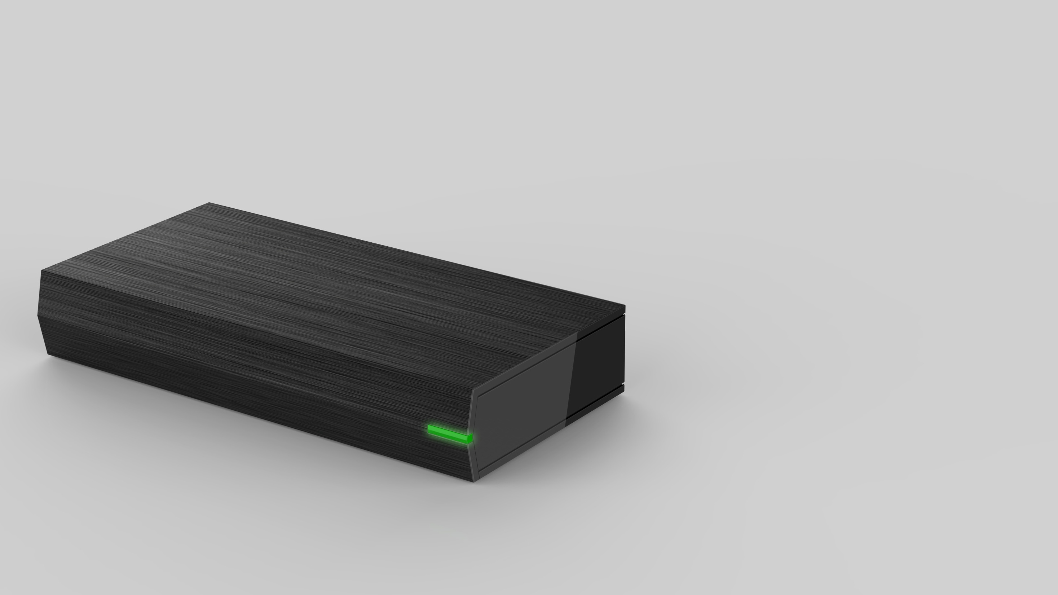
MINI BOX
Proposal

Slide 12
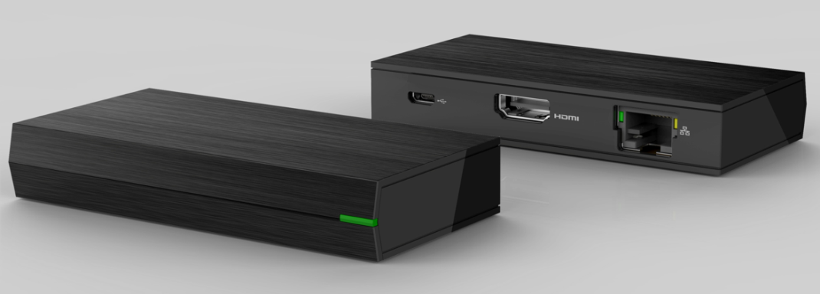
Mini Box Specification
OTT Box ID
Technical Specification
Chipset | Memory
AML S905X3 | 3 GB LPDDR4 8 GB eMMC flash (MLC type)
Interface | Features
HDMI 2.1 @ 4Kp60 output x1, HDCP 2.2 RJ-45x1; 10/100/1000 Mbps LED for power on/off indication Micro-USB for 5V @ 1A DC input | Main stream box for HEVC/4K video Google casting support Preload apps for TV services Over-The-Air image upgrade Android TV pre-certified Netflix NTS (optional)
Networking
10/100/1000 Base-T Ethernet Wi-Fi 802.11 ac/a/n 2x2 single band Bluetooth 5.0 w/ BLE
Operating System
ATV (Android Q) Widevine Level 1/PlayReady DRM support
Highlight
Dimension | - 2 proposals for selection
Wi-Fi 5GHz 2T2R Connection | - Support 802.11 ac/a/n
Operation environment | Temperature 0 ~ 40°C Humidity 10% ~ 90% relative humidity
Power adapter | 100~240VAC input, 5V/2A DC output
Safety/ Cert. | TBD
12
Notes:
12

Slide 13
S905X3 OTT Stick Block Diagram
LPDDR4
SDRAM
3GB
eMMC
Flash
8GB
Crystal
24MHz
32bits
8bits
S905X3
SoC
Back Panel
Front Panel
HDMI Female
Connector
TMDS/DDC_I2C/CEC/HPD
Ethernet PHY
RGMII
GPIO
RGB LED*1
RJ45 Connector
Micro USB
(USB2.0)
USB OTG D+/D-
GPIO
Button*2
5V
UART
SDIO
eFuse
VDD_EE
Power Block
DC-DC
VDD_CPU
VCC_3.3V
Wi-Fi 11ac/ BT 5.0
2T2R Chipset
RTL8822CS
Chip
Antenna *2
DDR_1.1V
VCC_1.8V
Crystal
40MHz

Slide 14
S905X3 OTT Stick Power Consumption Chart
5V/611mA
3.055W
5V/128.4mA
0.84V/688mA
DCDC
VDD_EE
Efficiency = 90%
5V/82.4mA
0.84V/441.6mA
VDDCPU
DCDC
Efficiency = 90%
5V/233.2mA
3.3V/318mA
3.3V/280mA
BT/WiFi
chip
DCDC
Efficiency = 90%
3.3V/25mA
8GB
eMMC
5V/15mA
1.8V/83mA
RGB LED
Ethernet
PHY
3.3V/13mA
5V/64mA
DCDC
1.8V/160mA
1.8V/67mA
●
VDDIO_BOOT/AVDD18/VDDIOX
1.8V/10mA
LPDDR4 3GB
5V/88mA
DCDC
1.1V/360mA
Efficiency = 90%

Slide 15
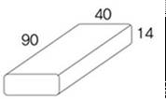
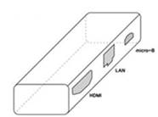
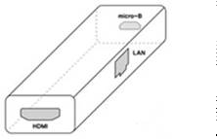
SKB external appearance requirement
Items | Target
External appearance | Rectangle type (unit: mm)
Connector Location | Proposal A Proposal B

Slide 16
Summary
 | Proposal A-1 | Proposal A-2
Size | 90mm x 40mm x 14mm | 90mm x 45mm x 14mm
PCB process | 8 layer, HDI | 8 layer
Key buttons placement | Left side | Front side
Cost | Higher | Lower
Although proposal A-1 meets the spec but the cost is higher. On the other hand the proposal A-2 depth is not far from the spec, the cost is rather advantageous.

Slide 17
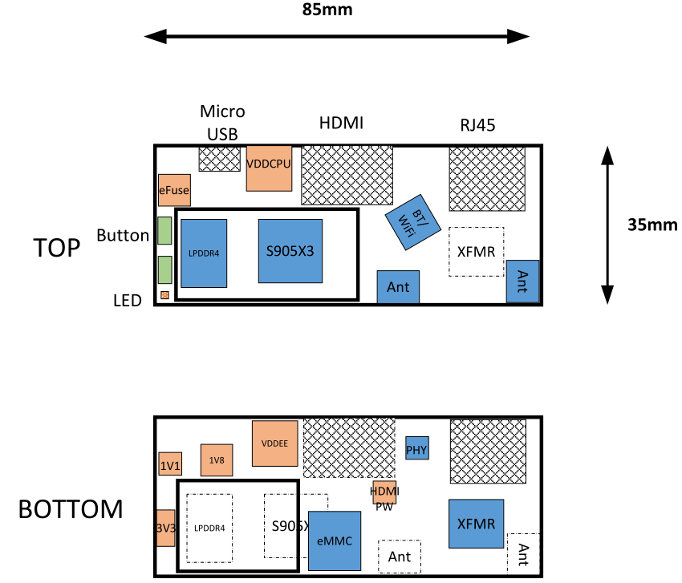
PCBA placement – Proposal A-1
Based on the PCBA size: 85mm x 35mm x 1mm, FXN propose housing size is 90mm x 40mm x 14mm which is able to achieve SKB’s requirement
Use sink type RJ45 connector to achieve 14mm height of housing
Use HDI layout process and the two buttons could be moved to the left side of housing to achieve 35mm depth of housing size
2 x chip on board antenna design

Slide 18
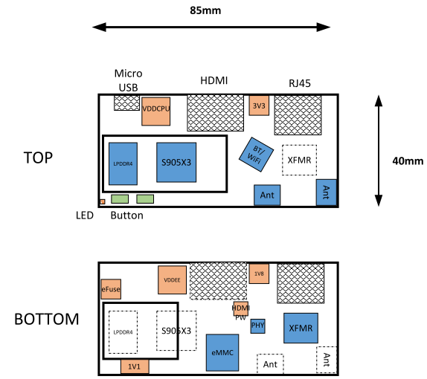
PCBA placement – Proposal A-2
Based on the PCBA size: 85mm x 40mm x 1mm, FXN propose housing size is 90mm x 45mm x 14mm
Use sink type RJ45 connector to achieve 14mm height of housing
The two buttons are placed in the front of housing. Regardless of position the depth can not further reduce
2 x chip on board antenna design

Slide 19
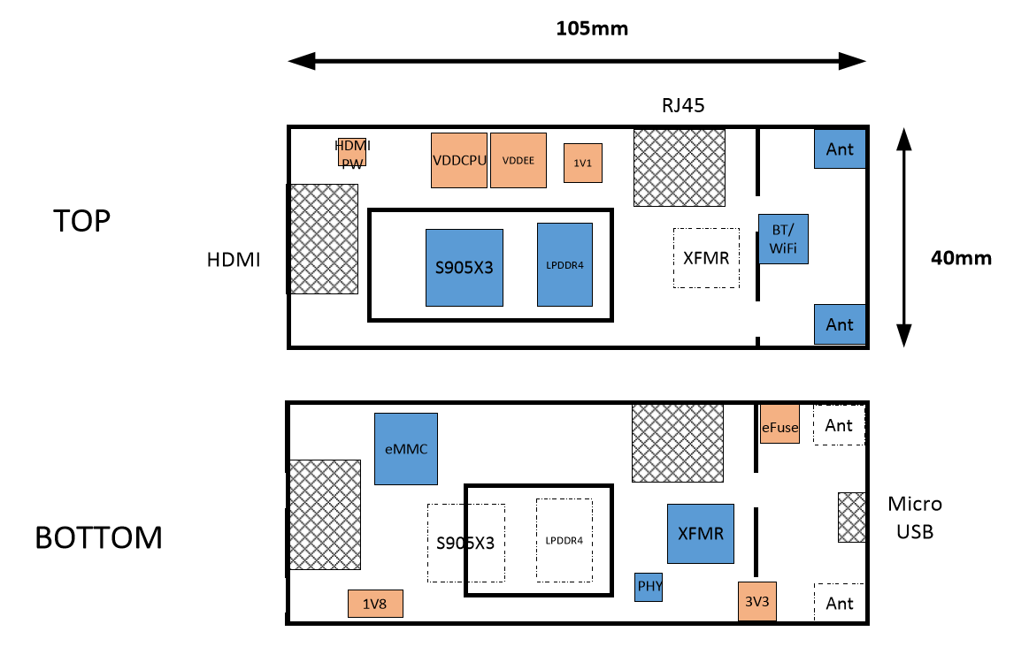
PCBA placement – Proposal B
If the USB and HDMI connectors are placed at 2 sides, the layout trace routing will be more complicated and hence enlarge the length.(placement shown below)
Also the Ethernet port restricts the shortening of width.
PCB size 105 * 40mm already exceeds required spec 90*40 mm, can’t satisfy the requirement.
Even with HDI solution, the width could be reduced to 35mm, the length still cannot be further reduced.

Slide 20
WiFi Testing

Slide 21
Wi-Fi Development Process (1/5)
Conducted test
Antenna test
Radiation test
Design prepare
OTA test
Wi-Fi spec. review
  Transmit power
  Frequency Band
Wi-Fi solution
  Interface : SDIO
  Chipset vendor : REALTEK
Locating Antenna position in STB
  Mechanical drawing
  Simulation(HFSS)
  RF cable path
Schematic and Layout reviewed by vendor

Slide 22
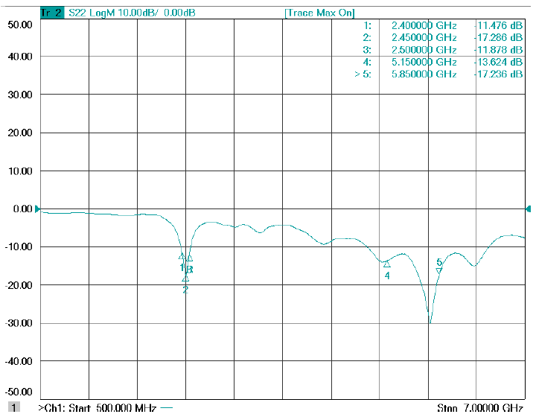
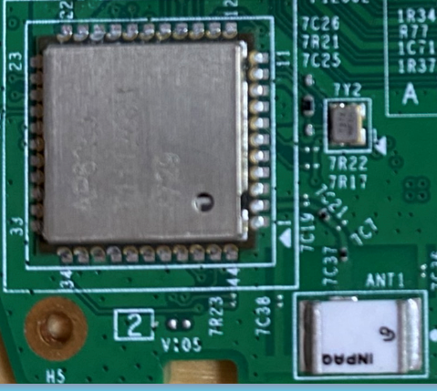
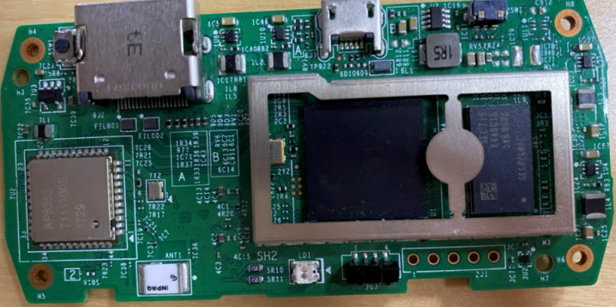
Design prepare
Simulation (HFSS)
Return Loss
Mechanical drawing
This picture is only for reference.
WIFI module
RF path
Chip antenna
Efficiency
Chip antenna | 5.15G | 5.47G | 5.85G
Efficiency(%) | 63.36 | 66.20 | 63.51
WIFI
module
SOC
* Above is reference data, need to use actual PCB to test

Slide 23
Wi-Fi Development Process (2/5)
Conducted test
Antenna test
Radiation test
Design prepare
OTA test
802.11a/n/ac Spec. verification
  Transmit power measurement
  Transmitter spectral mask test
  Transmitter spectral Flatness
  Local Oscillator suppression & Center frequency tolerance
  Transmit Center Frequency Error
  Transmit Power On and Power Down Ramp
  Transmit modulation accuracy (EVM)
  Receiver minimum input level sensitivity
  Receiver maximum input level
  Adjacent channel rejection and Non-adjacent channel rejection
Chipset vendor review Conducted performance

Slide 24
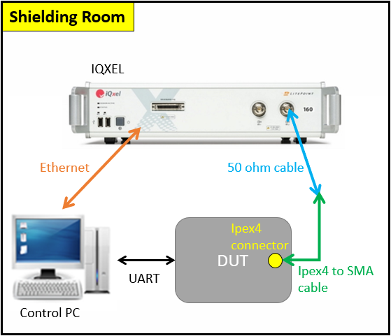
Conducted test
Test Step
DUT install RF test tool of module
Control PC connect IQxel or others equipment via Ethernet
Connect DUT and IQxel by 50 ohm cable and Ipex4 to SMA cable
Setting parameter by IQxel
Setting parameter by RF test tool and start test
Repeat step4 and step5
Test diagram
Test equipment list
 | Q’ty
Control PC | 1
IQxel | 1
Ethernet cable | 1
50 ohm cable | 1
Ipex4 to SMA cable | 1

Slide 25
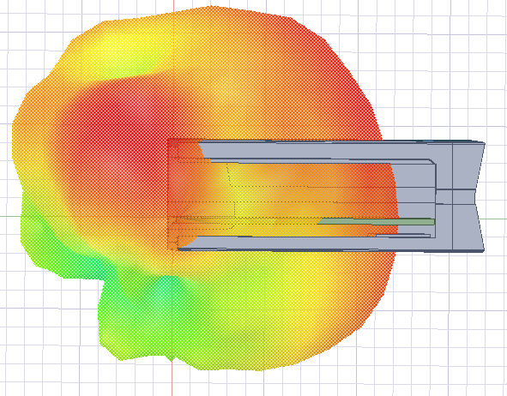
Wi-Fi Development Process (3/5)
Conducted test
Antenna test
Radiation test
Design prepare
OTA test
internal design target
  Frequency 5GHz: 5150 ~ 5350, 5470 ~ 5850MHz
  Directivity: ≥ +3dBi
  Efficiency: ≥ -50%
  VSWR: ≤ 2.0:1
  Return Loss : ≤ -10dB
Antenna passive test with mounting STB
  Antenna position: Simulation by using 3D antenna tool (HFSS)
  Antenna performance measurement in Anechoic chamber
The reason to reduce peak gain spec from +5dBi to +3dBi
Based on environment of dongle, expected to use chip antenna, but pattern design of chip antenna is fixed and the peak gain can’t be improved by adjusting antenna matching
Based on the design experience in previous project, the peak gain of chip antenna is about +3dBi
Peak gain of previous project
 | 5150 | 5470 | 5850
Peak gain (dBi) | 3.68 | 3.58 | 3.45
Antenna 3D plot
* Above is reference data, need to use actual PCB to test

Slide 26
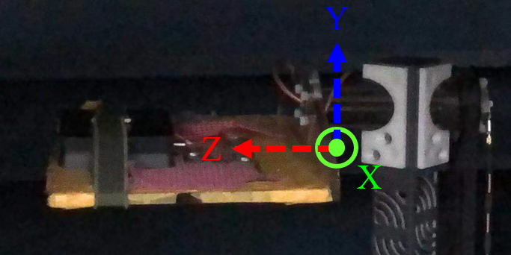
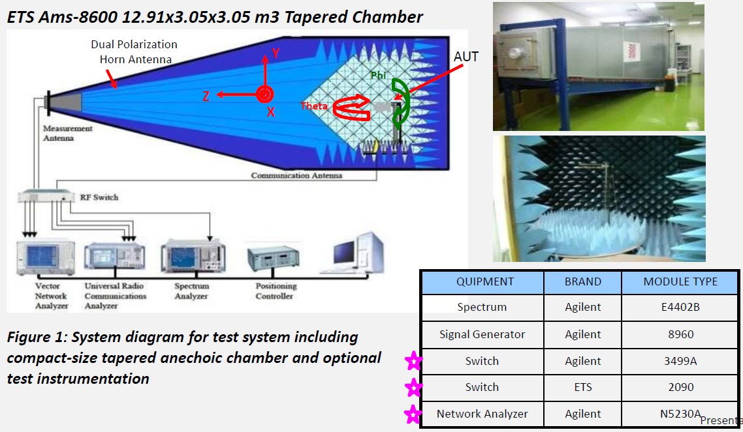
Antenna Test
Antenna Anechoic chamber
DUT
DUT
Test Step
DUT place on test platform
Parameter setting by test tool
Generate antenna gain, efficiency, 2D and 3D plot

Slide 27
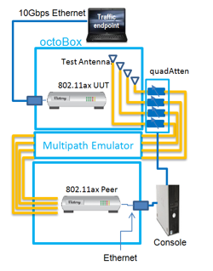
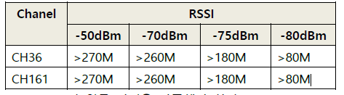
Wi-Fi Development Process (4/5)
Design prepare
Conducted test
Antenna test
Radiation test
OTA test
RvR(Wi-Fi Throughput Rate vs. Range in TCP) test
  Test Spec.:
  Test condition
  - In anechoic chamber or shield room
WIFI Throughput Tx/Rx test
- In anechoic chamber
(Suggest test criteria for next page)
Octobox environment setting
Please refer to radiation test page

Slide 28
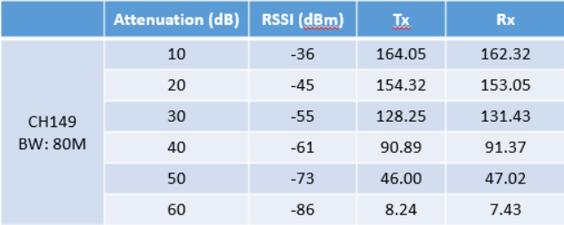
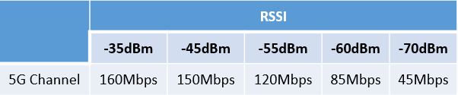
Test criteria
The following table is RvR test result using WIFI module (chipset : RTL8822CS), when the attenuation is 10dB, throughput less than 200Mpbs, so unable to meet over 270Mbps at -50dBm
Suggest test criteria
Because the throughput test result is related to the SOC, Therefore, it is suggest that the test criteria as below table
* Above is reference data, need to use actual PCB to test

Slide 29
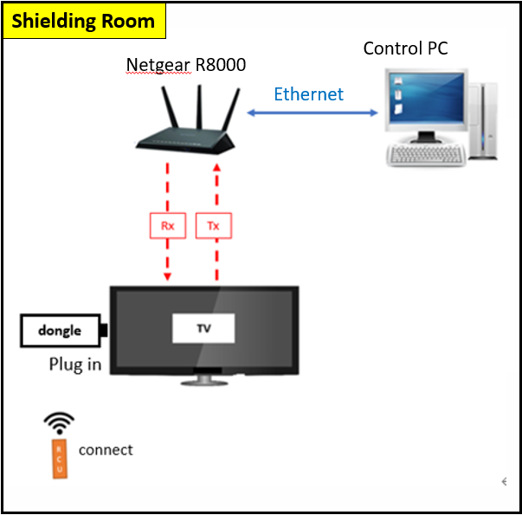
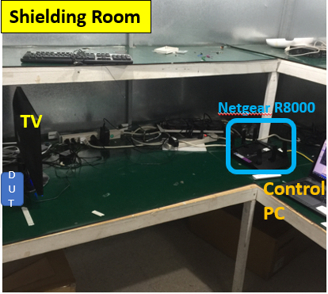
Radiation test
Test Condition : RCU pairing/RCU non pairing
5GHz (unit: 866Mbps) |  | Channel 36 | Channel 149 | Channel 161
RCU no pairing | Tx | 268 | 297 | 280
 | Rx | 256 | 256 | 257
RCU pairing | Tx | 265 | 293 | 277
 | Rx | 250 | 248 | 254
Test diagram
Actual test environment
Test Condition : RCU pairing + Play 4K Video
5GHz (unit: 866Mbps) |  | Channel 36 | Channel 149 | Channel 161
RCU pairing | Tx | 250 | 262 | 260
 | Rx | 236 | 256 | 237
Shielding room size
2.34m*2.34m*2.19m
* Above is reference data, need to use actual PCB to test

Slide 30
Wi-Fi Development Process (5/5)
Conducted test
Antenna test
Radiation test
Design prepare
OTA test
Indoor OTA test
  Test Spec.: Min. Throughput ≥ 20Mbps @spot No
  Test condition
  - CH36 @5GHz and CH161
  - Test spot on FXN TW office
Outdoor OTA test
  Test Spec.: comparison data for reference sample
  Test condition
  - CH36 @5GHz and CH161
- Test place where is non line of sight W/O WLAN AP
MP prepare
  Mass product automation program
  Manufacturing Spec. fix
Please refer test environment and procedure to next page

Slide 31
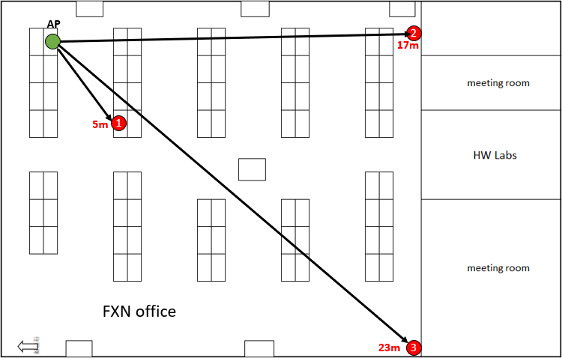
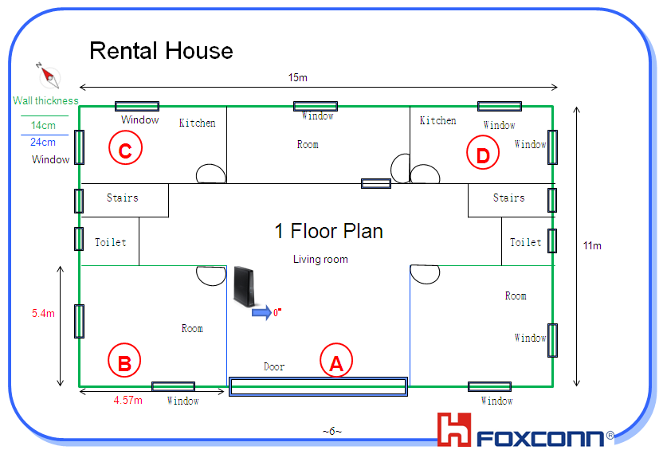
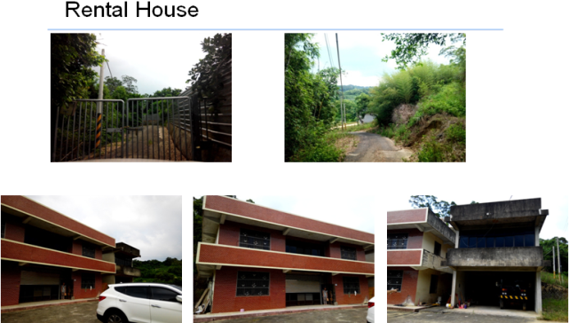
OTA test
Test Step for Indoor and Outdoor OTA test
DUT install Iperf3 client APK
The AP is placed at the green point in the picture
The DUT is placed at the red point 1 in the picture
Start Rx test
Repeat step 3 and step 4
Indoor
NLOS - Rental House Test
Live signal without neighbors’ WiFi interference
Outdoor

Slide 32
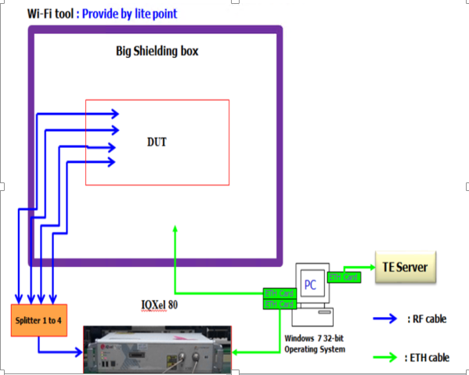
Wi-Fi Manufacturing Process (1/4)
Conducted test
Radiation test
Calibration
OBA test
Wi-Fi Calibration
Wi-Fi Verification(Conducted test)
Using IQxel80 or IQM8W
Description | Unit
PC | 1
IQxel80 or IQM8W | 1
RF connector | 4
RF cable | 5
Attenuator(10dB) | 1
Ethernet cable | 3
Shielding Box(Big) | 1
Fixture | 1

Slide 33
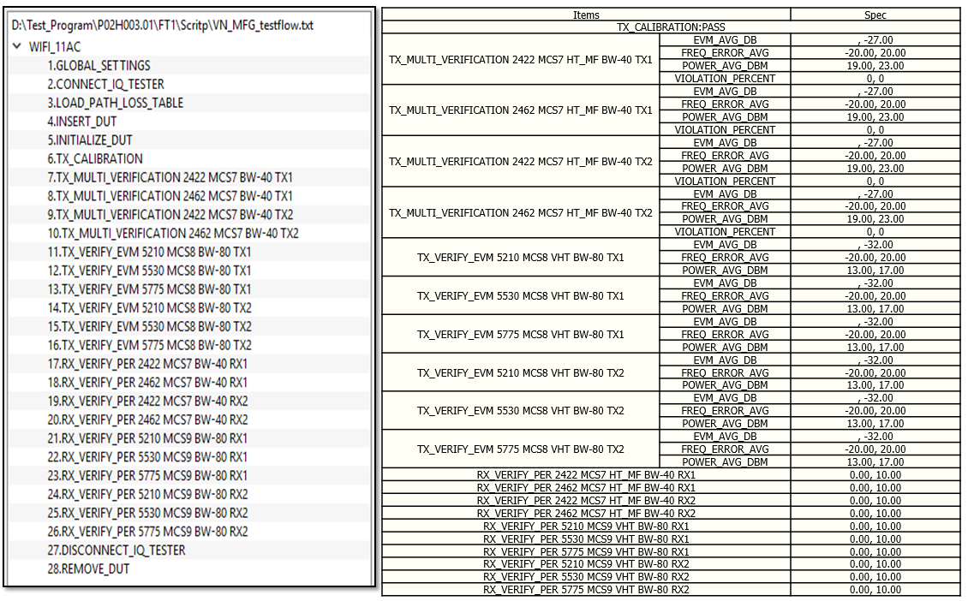
Wi-Fi Manufacturing Process (1/4)
Conducted test
Radiation test
Calibration
OBA test
Wi-Fi Calibration spec
  List up

Slide 34
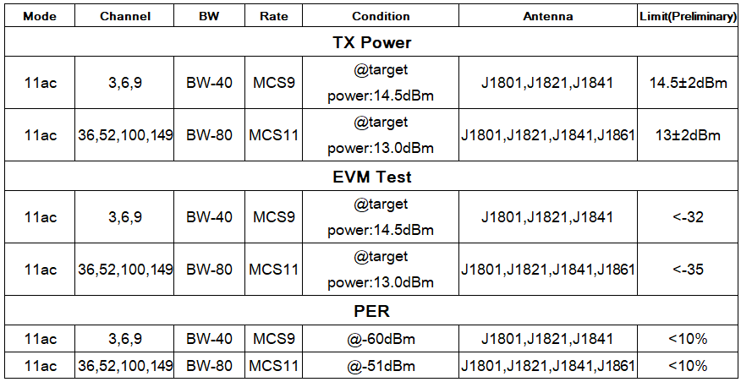
Wi-Fi Manufacturing Process (2/4)
Calibration
Radiation test
Conducted test
OBA test
WIFI Conducted test
  Test diagram
  Test spec
802.11a/n/ac . Frequency list, Test spec, Calibration & verification or only have verification
  Transmit power measurement
  Transmitter spectral mask test
  Transmit Center Frequency Error
  Transmit Power
  Transmit modulation accuracy (EVM)
  Receiver minimum input level sensitivity
  Receiver maximum input level

Slide 35
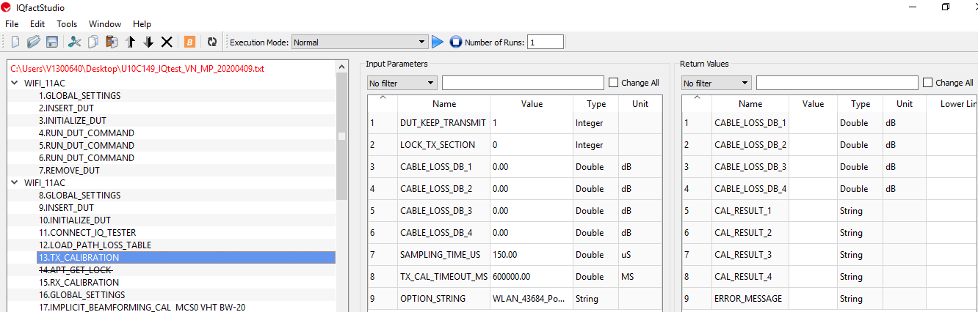
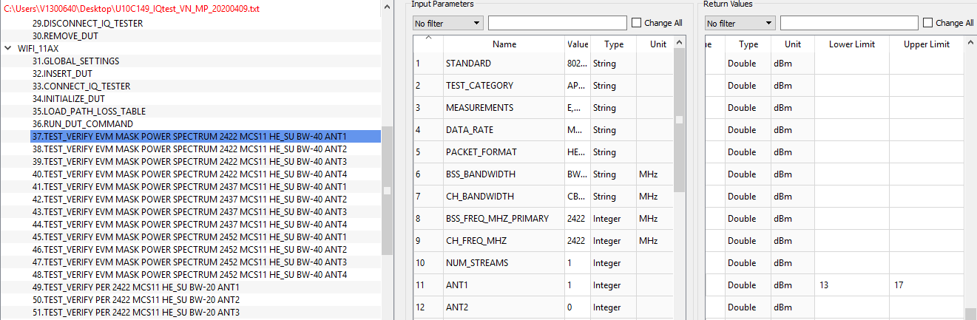

Wi-Fi Manufacturing Process (2/4)
Calibration
Radiation test
Conducted test
OBA test
WIFI Conducted test
  Test diagram
  Test spec

Slide 36
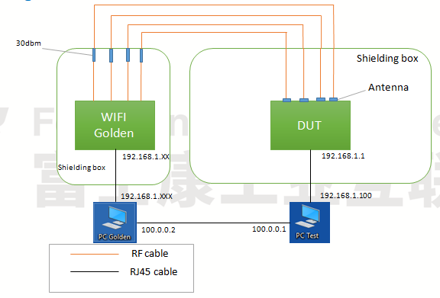

Wi-Fi Manufacturing Process (2/4)
Calibration
Radiation test
Conducted test
OBA test
Throughput test
  Test diagram
  Test spec

Slide 37
Wi-Fi Manufacturing Process (3/4)
Calibration
Conducted test
Radiation test
OBA test
WIFI Radiation test
  Test diagram
  Test spec
* ALT Comment : Please update mass production test diagram and test environment
* FXN : It’s the same with WIFI throughput test

Slide 38
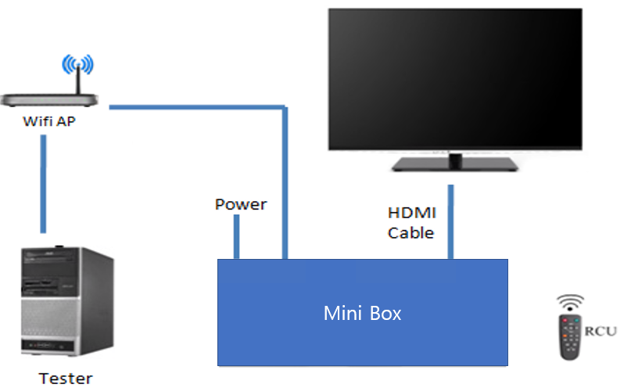
Wi-Fi Manufacturing Process (4/5)
Calibration
Conducted test
OBA test
Radiation test
WIFI OBA test
  Test diagram
  Test spec->Connect internet and play YouTube content
* ALT Comment : Please update mass production test diagram and test environment

Slide 39
Milestone & Reliability Test Plan

Slide 40

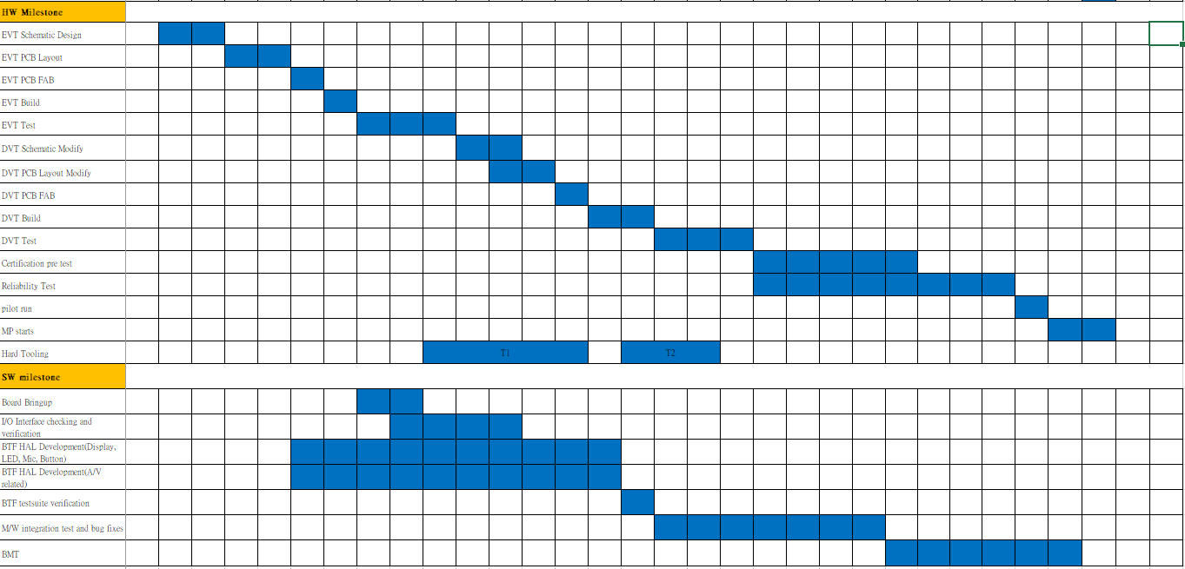
Development schedule

Slide 41
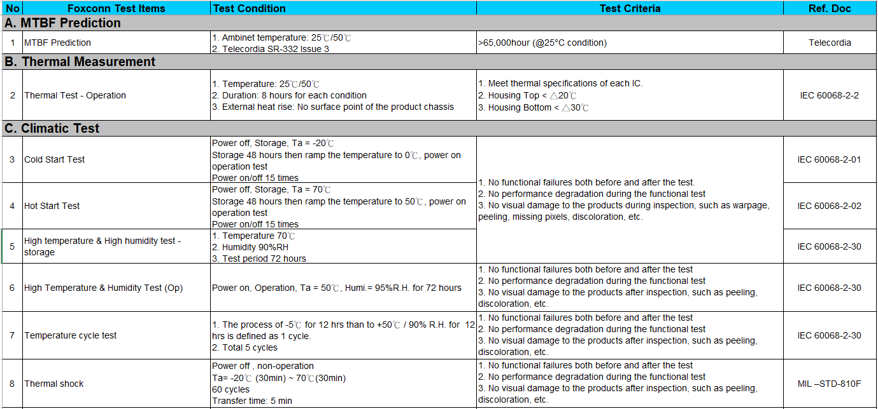
Reliability Test Plan

Slide 42
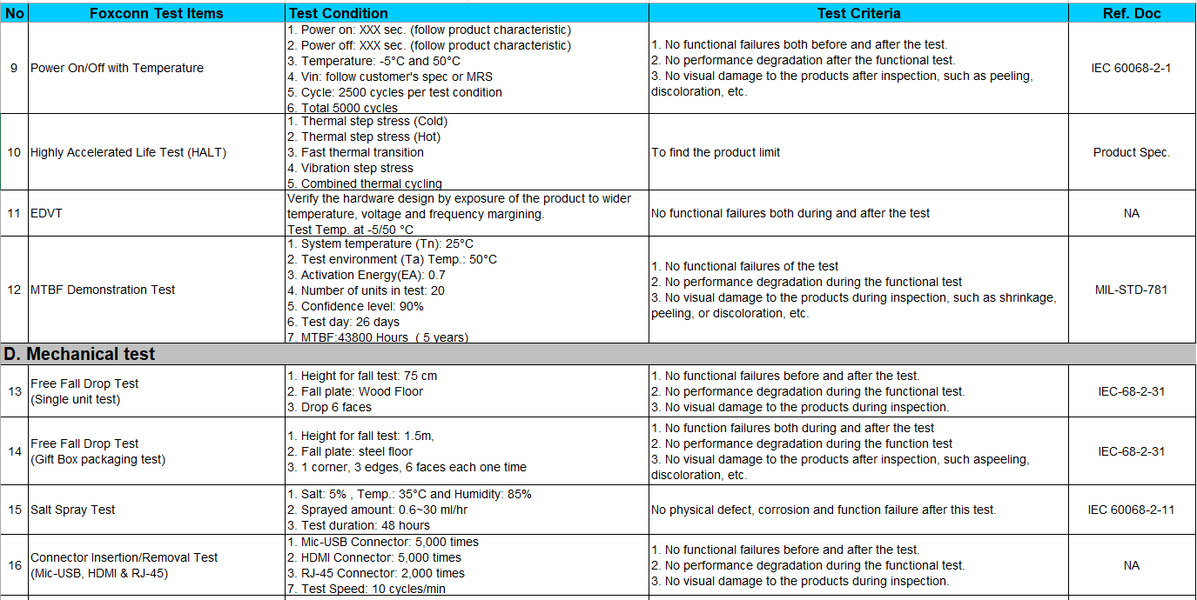
Reliability Test Plan-Cont’

Slide 43
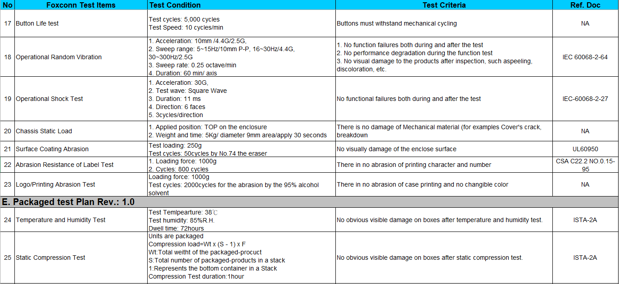
Reliability Test Plan-Cont’

Slide 44
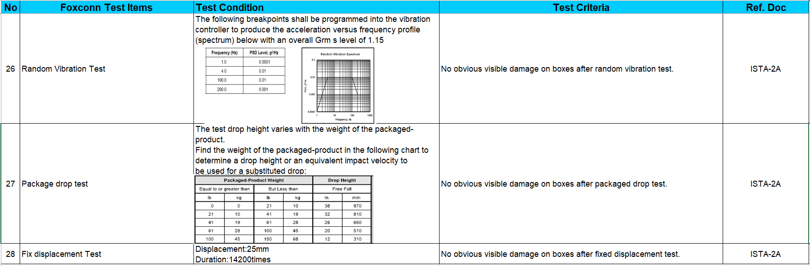
Reliability Test Plan-Cont’

